Slide 2
Outline
Introduction
The vision
The plan
The tasks
T1: Wind farm scale
T2: Cluster scale
T3: Coupling Wind farm to Cluster scales
T4: Other offshore wind farm challenges
WP1 within DTOC
Interdependencies with other WPs

Slide 3
Introduction Purpose
“Identify, benchmark, provide guidelines for and couple the existing wake models that can operate over wind farm scale and cluster scale.”

Slide 4
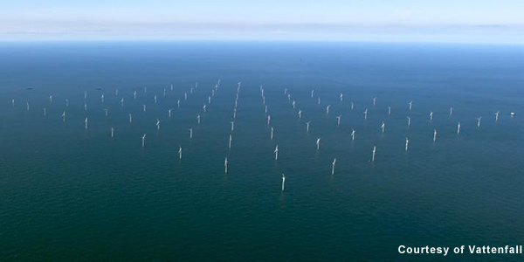
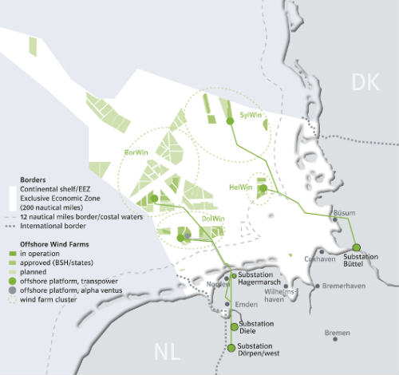
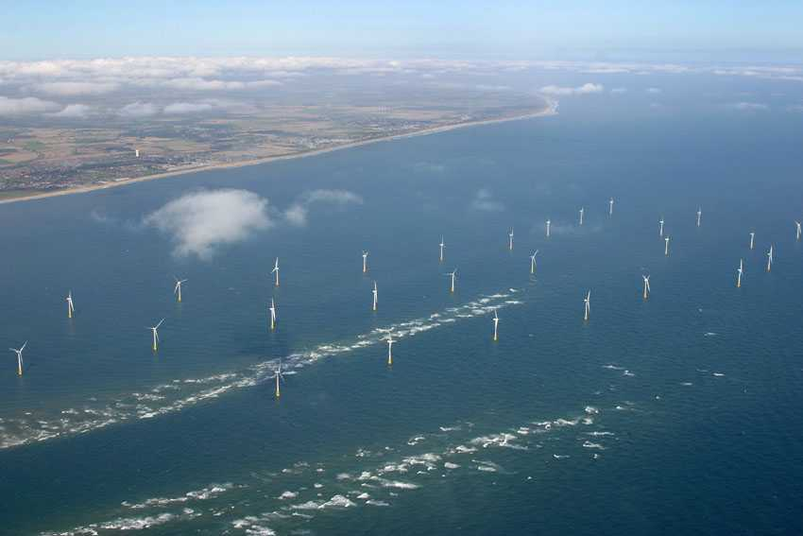
Introduction The “big wake” picture
Wind farm scale
wake model (T1.1)
http://www.renewbl.com
Wind
Coupling (T1.3)
Upstream WF
Wake info
Wind farm scale
wake model (T1.1)
Coupling (T1.3)
WP3
Cluster scale
wake model (T1.2)
Target WF
http://www.offshore-power.net

Slide 5
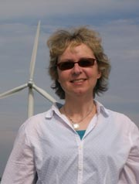
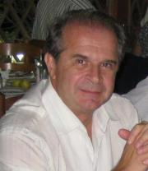
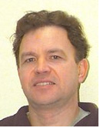
Workstreams
Jan.
2013
Mar.
2013
Jun.
2012
June
2013
Jan.
2012
D1.3
Wind farm wake models Benchmarked
Identification
Guidelines
T1.1
Benchmark
D1.4
Cluster wake models
Benchmarked
Identification
Guidelines
T1.2
Benchmark
D1.2
Coupled models Benchmarked
Benchmark
WP5
D1.1: Data for coupled models
T1.3
DX:Other offshore wind farm challenges
T1.4

Slide 6
Outline
Introduction
The vision
The plan
The tasks
T1: Wind farm scale
T2: Cluster scale
T3: Coupling Wind farm to Cluster scales
T4: Other offshore wind farm challenges
WP1 within DTOC
Interdependencies with other WPs

Slide 7
Task 1.1: Wind Farm Scale
Partners: IU, Risoe DTU, UPORTO, CRES, ECN, CENER, RES, Hexicon, BARD
Objective: Identify wake model performance of existing engineering and CFD models.
Advance in providing a wider range of observations with quantitative performance metrics
Addition of turbulence and stability parameters
Metrics include: wake width, wake depth, power production by row and by wind farm, momentum losses through the wind speed profile.
Mean and dynamic cases

Slide 8
Task 1.1: Wind Farm Scale
WP1.1.1. Identify wake model performance of existing engineering and CFD models.
Identify models taking part
Identify ‘Standard cases’: Fixed wind speed/direction
Identify ‘Dynamic cases’. From time series e.g. at Horns Rev
Role of additional turbulence, stability parameters
Define additional metrics for assessing model ‘skill’
Work in conjunction with IEA Wakebench

Slide 9
Task 1.1: Wind Farm Scale
Identified Wake Models 1/2
Engineering models:
NO Jensen + Frandsen (DTU-WAsP/Park)
Ainslie (RES)
DWM, RDWM (DTU)
Linearized / Parabolized CFD models:
Fuga (DTU)
FarmFlow (ECN)

Slide 10
Task 1.1: Wind Farm Scale
Identified Wake Models 2/2
Nonlinear CFD models:
ECNS: LES AD/AL (ECN)
CRES-flowNS: RANS AD (CRES)
CRES-farm: flowNS + engineering model (CRES)
CFDWake: OpenFoam RANS AD (CENER)
EllipSys: LES & RANS AD/AL (DTU)
VENTOS: RANS AD RANS (UPORTO)

Slide 11
Task 1.1: Wind Farm Scale
Timetable
Feb 2012 Identify models
May 2012 Make available data for Round one cases (w. Wakebench)
Jun 2012 Deadline: Compile results from Round one Cases
Sep 2012 Results Round One Cases
Nov 2012 Definition & Data Round Two Cases
Mar 2013 Deadline: Round Two Cases
Jun 2013 Results from Round Two Cases / Recommendations for industry users

Slide 12
Outline
Introduction
The vision
The plan
The tasks
T1: Wind farm scale
T2: Cluster scale
T3: Coupling Wind farm to Cluster scales
T4: Other offshore wind farm challenges
WP1 within DTOC
Interdependencies with other WPs

Slide 13
Task 1.2: Cluster Scale
Participants: DTU, CIEMAT, CLS, CENER, ECN, Hexicon
Sub-tasks:
1.2.1: Identify wake model performance for cluster scale wind farm using mesoscale models
1.2.2: Uncertainty from wake models on net efficiency
1.2.3: Recommendations for industry user
Deliverables: D1.4 – Benchmark report on wake models at the cluster scale (M18, DTU)

Slide 14
Task 1.2: Cluster Scale
Identified Wake Models:
Mesoscale models:
WRF (DTU, CIEMAT, RES)
Skiron (CENER)
Mesoscale wake models:
WRF-wake: WRF+PARK (DTU)
Farm-farm (ECN)
RESWFYield: WRF+Ainslie (RES)

Slide 15
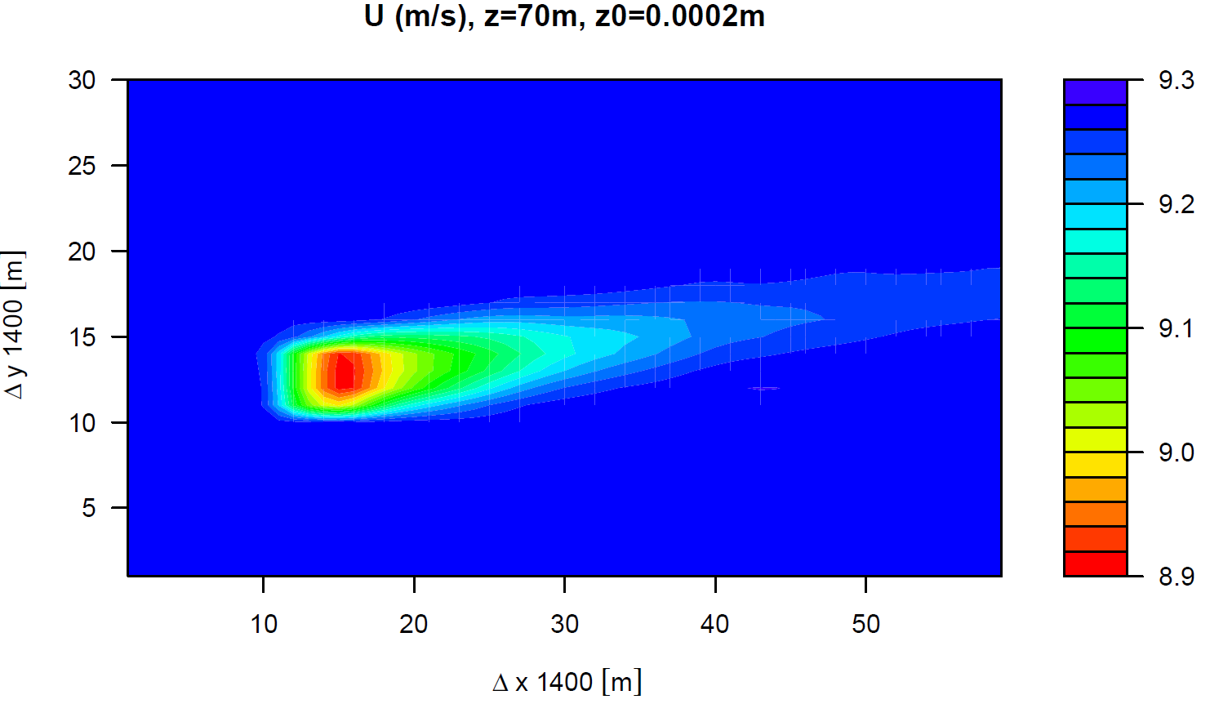
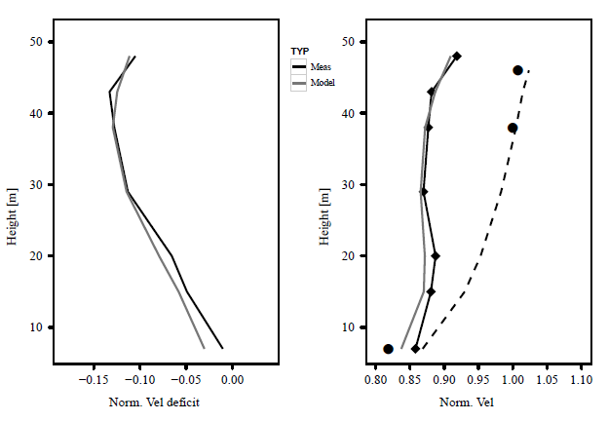
Task 1.2: Cluster Scale
Wake model concepts for the cluster scale
Identify wake model performance for cluster scale wind farm using mesoscale models
Uncertainty from wake models on net efficiency.
Recommendations for industry user.
Benchmark report on wake models at the cluster scale (month18)
From Volker (2012): Left: Normalized velocity deficit for the measurements (in black) and the model (in grey). Right: Measured up-stream velocity (dots) and the logarithmic fit (dotted line), the down-stream measurements (diamonds) and the measurement interpolation (black line) plus the model wake velocity (grey line).
Mesoscale wake modelled in WRF using parameterization by Volker (2012) for Hornsrev for a westerly wind find forcing.

Slide 16
Task 1.2: Cluster Scale
Timetable
Feb 2012 Identify models
Mar 2012 Make available data for Round one cases
Jun 2012 Deadline: Compile results from Round one Cases
Sep 2012 Results Round One Cases
Nov 2012 Definition & Data Round Two Cases
Mar 2013 Deadline: Round Two Cases
Jun 2013 Results from Round Two Cases/Recommendations for industry users

Slide 17
Outline
Introduction
The vision
The plan
The tasks
T1: Wind farm scale
T2: Cluster scale
T3: Coupling Wind farm to Cluster scales
T4: Other offshore wind farm challenges
WP1 within DTOC
Interdependencies with other WPs

Slide 18
Task 1.3: Coupling Wind Farm – Cluster scale
Participants: CRES, DTU, IU, CIEMAT, UPORTO, ECN, CENER, RES
CRES: Investigate strategies for meso-micro scale interaction
micro-to-meso : WF/far-wake model
meso-to-micro : Unsteady boundary conditions
DTU:
WRF <=> engineering wake model
WRF => EllipSys unsteady coupling
RES: RES-WFYield (WRF-Ainslie model)
CIEMAT: WRF / ROMS / SWAN coupling
Others?

Slide 19
Outline
Introduction
The vision
The plan
The tasks
T1: Wind farm scale
T2: Cluster scale
T3: Coupling Wind farm to Cluster scales
T4: Other offshore wind farm challenges
WP1 within DTOC
Interdependencies with other WPs

Slide 20
Task 1.4: Other offshore wind farm challenges
Participants: Statoil, Carbon Trust
Marine operation (Access, Operation)
Wind turbine life cycle
wind/wave resource
Water depth
Sea bottom condition
Electrical grid connection
Foundation
Installation
Operation & Maintenance
Decommission
Risk assessment

Slide 21
Outline
Introduction
The vision
The plan
The tasks
T1: Wind farm scale
T2: Cluster scale
T3: Coupling Wind farm to Cluster scales
T4: Other offshore wind farm challenges
WP1 within DTOC
Interdependencies with other WPs

Slide 22
Connection with other work-packages
Wake information to be communicated to WP3:
Wind turbines power production
Wind farm fatigue
Uncertainties
Power quality (sensitivity to WS / WD)
Other information to WP3:
Cost functions for offshore environment (T1.4)

