Slide 2
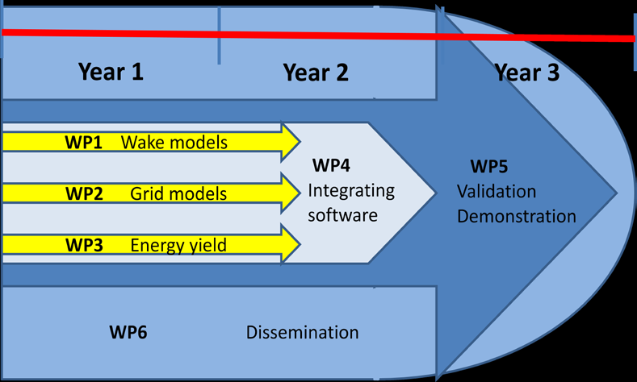






Project structure and general timeline
Participants in WP2:

Slide 3
WP2 :: Objectives
WP2: „Interconnection Optimisation and Power Plant System Services“
Objectives:
  to develop a design tool and procedure for the optimisation of the electrical design of offshore wind farm clusters…
  ….including the provision of power plant system services by the cluster.

Slide 4
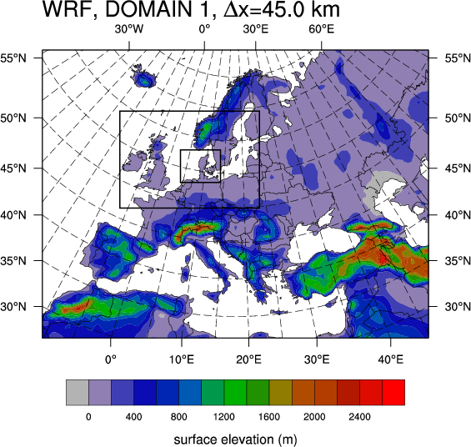
WP2 :: Models :: DTU :: CorWind
CorWind model of DTU has the ability to:
  quantify the wind power variability
  by simulating correlated wind speeds
  over a large geographical area,
  i.e. North Sea;
  for large number of wind farms and
  with time steps down to one second;
  the output can be wind speed and/or power (individual wind turbines, wind farm level or group of wind farms);
  it uses as input climate data and simulates the stochastic variability inside the hour.
Climate model resolution

Slide 5
WP2 :: Models :: SINTEF :: NET-OP
Energy Research
Tool to find optimal offshore grid expansions
Example – North Sea offshore grid:
Existing connections
Allowed new connections
Optimal new connections
(capacity indicated)
Notes:
These figures show an example of previous use of the NET-OP tool to find optimal offshore DC grid expansion.
- The left figure shows the starting point, with existing grid and allowed expansions (that are included in the optimisation). Each country is represented by one node, with generation and load.
- The right figure shows the result of a simulation (under certain assumptions). Chosen grid expansions are indicated in green, with capacities as sown. Nodes are coloured according to whether they have both load and generation (pink), only load, only generation (blue) or no load or generation (black).

Slide 6
WP2 :: Models :: CIEMAT :: Integrated models
GCM
LAM
Expertise on Short- and Very Short-term Prediction
Wind Power Prediction
PBL
modelling
Mesoscale: WRF
Integration between
Dynamical Model (NWP based approach) and
Statistical Model (Time Series based approach)
Microscale Modelling:
Orography, Roughness, Obstacles
Advanced
MOS
On-line
Data
Power Curve Modelling
Exogenous Variables
Statistical Model
Wind Farm Output
Wind Farm Output
Dynamical
Statistical
Autoregressive Models
Fuzzy Logic
Neural Nets
etc.
Advanced Integration
by CIEMAT/Global Forecasters
Final Prediction and Confidence Band

Slide 7

WP2 :: Models :: IWES :: WCMS
Wind Cluster Management System.
Grid calculations, weather forecast processing, set points for wind farms.
Applications: frequency control, active and reactive power control, reserve provision.
Into EERA-DTOC scope:
    State-of-the-art electrical models for cluster operation in WP2;
    Re-development required → Become into a simulation tool.
Forecast
engine
TSO
WCMS Engine
DB
Control
strategy
Control
strategy
Control
strategy
Control
strategy
Cluster control
Forecast
engine
Dispatch
WCMS Engine
DB
Dispatch
Scheduler
Driver manager
WF
Driver
WF Sim
Driver
WF Sim
v 1.0.0

Slide 8
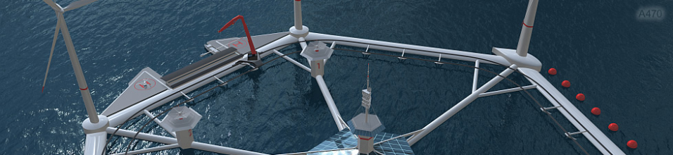
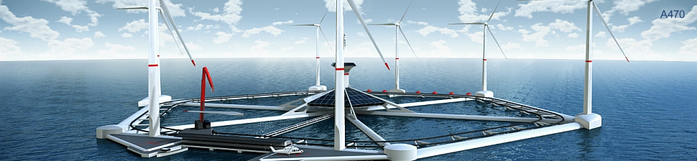
WP2 :: Academic and Industrial Partners
  Identification of offshore wind power plant design and control to provide conventional plant services.
  Grid codes compliance.
  Grid connection and cabling interconnection design.
  Know-how transfer regarding grid connection from offshore platforms to onshore electrical grid.
  Grid connection dimensioning for Hexicon wind farms
  (5+ platforms).

Slide 9
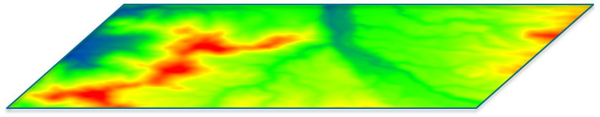
WP2 :: Models :: Interactions
Fraunhofer IWES
P,Q
WCMS model
Analysis of the availability of power plant system services
2.4
P,Q
P,Q
P,Q
P,Q
Strath
SINTEF
Grid Codes compliance
PSS/e & PSCAD/EMTDC
Transient analysis
2.3
SINTEF
Fraunhofer IWES
Strath
Statoil
Hexicon
NET-OP model
Grid optimization
Steady-state
2.2
Analysis on variability & predictability
2.1
Risoe DTU
Fraunhofer IWES
CIEMAT
CorWind model
Off-shore development
Wake modelling
WP1

Slide 10
WP2 :: Deliverables
2.1. Power output variability and predictability
M2.1: Tool Module
D2.8
Design tool module
Report on design tool
Risoe DTU
Fraunhofer
CIEMAT
18
2.2. Grid connection and cabling interconnection design
D2.1
D2.2
D2.3
Design tool module
Design procedure
Report
SINTEF
Fraunhofer
Starth
Statoil
Hexicon
12
2.3. Design verification and grid code compliance
D2.4
D2.5
Strath
SINTEF
Verification procedure x2
12
2.4. Analysis of the availability of power plant system services of a cluster
D2.6
D2.7
Fraunhofer
15
Simulation tool
Analysis (report)
18

Slide 11
WP2 :: Timeline
WP
2.1
WCMS
model
CorWind
model
WP
2.1.2
WP
2.1.1
CIEMAT‘s
model
Test scenarios & input data (correlations)
WF designs & test scenarios
WP
2.2
Test scenarios & input data (correlations)
Module &
Procedure for grid design (PSS/e)
NET-OP
model
WP
2.2.1
WP
2.2.2
WP
2.3
Module
WP
2.3.2
WP
2.3.1
Procedure for Verification GC Compliance
Grid design (PSS/e)
WP
2.4

