Slide 2
Participants
ECN (WP-leader)
RISOE-DTU
Fraunhofer
CENER
SINTEF
Forwind (leader of WP5.1 and WP5.2)
CRES
CIEMAT
Uporto
Strath
CLS
Iberdrola
Statoil
Overspeed
Hexicon
Carbon Thrust
Statkraft
E.ON

Slide 3
Objectives/Sub Work Packages
Deliver the experimental data to validate the integrated off-shore wind farm design tool from measurements in the largest offshore wind farms existing today
WP 5.1 (Experiment)
Validate that the developed tool is accurate-by means of comparison with measuremets
WP 5.2 (Validation)
Demonstrate that the tool is useful to the industrial partners- by calculating scenarios of large wind farm clusters in close collaboration with industrial partners
WP 5.3 (Demonstration)

Slide 4
WP5.1: Experiment
Participants: Forwind, RISOE, CLS, CIEMAT, CENER, Fraunhofer
Measurements
BARD off-shore 1
Long range LIDAR inflow and wake measurements from two off-shore platforms
Load measurements
Ship based LIDAR measurements in the wake of a large off-shore wind farm
Production data
Milestones
First set of measurements and analyses of these data have been delivered to WP5.2 for validation of design tools (Month 12)
Second set of measurements and analyses of these data have been delivered to WP5.2 for validation of design tools (Month 24)
Experiments that have been performed are completed and reported (Month 30)

Slide 5
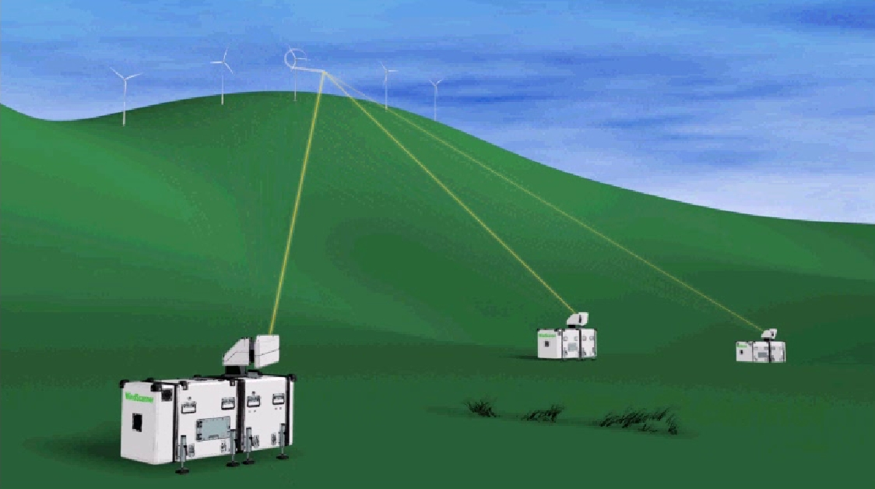
Offshore campaign at BARD 1
Access to SCADA data of the turbines
Atmospheric stability measurements
Wind scanner with 3 lidar systems
(c) ForWind – University of Oldenburg
(c) DTU Wind Energy – Windscanner.dk

Slide 6
WP5.2: Validation
Participants: ForWind, RISOE, CLS, CIEMAT, CENER, Fraunhofer, ECN, E.ON
Tasks:
WP5.2.1: Datasets of wake effects within wind farms and in between farms:
Existing data (e.g. Upwind)
Datasets from WP5.1
(Optionally) Carbon Trust data
Rödsand data from E.ON
WP5.2.2: Wake models are compared to measurements and possible improvements are identified
WP5.2.3: Datasets of electrical losses in wind farms are delivered.
WP5.2.4: Effect of mesoscale meteorology on wind farm operation and yield are measured and compared to the integrated wind farm design tools
Milestones
Validation of design tool and its reporting completed (Month 36). (Delivery of first datasets in month 12)

Slide 7
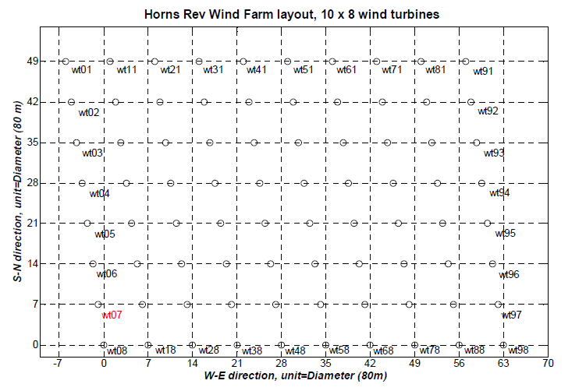
EU Project UPWIND
285°
255°
Notes:
Which consists of 8x10 turbines in a matrix lay-out

Slide 8
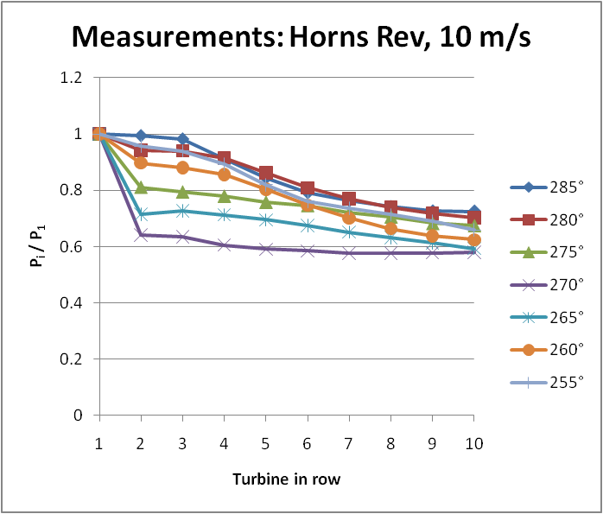
Picture: Rebecca Barthelmie and Kurt Hansen (DTU)

Slide 9
Lay-out Rödsand
Picture:
Petter Lindeloew Marsden (E.ON)

Slide 10
WP5.3: Demonstration
Participants: ECN, Overspeed, Iberdrola, Statoil, Carbon Trust, Hexicon, Statkraft, E.ON
General:
Delivery and Software training to end-users
Tools will be demonstrated on basis of likely scenarios. Industry is heavily involved in the definition
Tasks
WP5.3.1: Base scenario, considers future wind farms with characteristics similar to present wind farms, both inter and intra array layouts
WP5.3.2: Additional scenarios with different sized wind farms, including floating and up-scaled turbines , both inter and intra array layouts
WP5.3.3 Likely scenarios for future wind farm clusters to assess the energy yield on short and long time scale
Milestones
Design tool completed, if necessary improvements are implemented (Month 36)
Note:
Base and additional scenarios for WP5.3.1 and 5.3.2 delivered in month 12 and simulated in month 30
Scenerios for likely future wind farm clusters delivered in month 24

Slide 11
Summary
Until now the main focus of WP5 has been on WP5.1 (experiments)
Scenarios will be defined in due time in cooperation with end users (in and outside the project!)
It is suggested to define scenarios in a separate workshop

