Slide 2
Overview
Introduction
Net AEP of wind farm clusters (WP3.1)
Uncertainty analysis (WP3.2)
Work plan

Slide 3
1. Introduction
Objective:
Provide an accurate value of the expected net energy yield from the cluster of wind farms as well as the uncertainty ranges
Period: [M1-M18]
Deliverables:
  Report on procedure for the estimation of the expected net AEP and the associated uncertainty ranges [M18]

Slide 4
1. Introduction
AEP_{gross} (WP 3.1.1)
WF 1
-
L_{wakes}[V,θ] = Wake losses (WP1)
L_{el_WF}= Electrical losses (WP2)
L_{OM} = Operation and Mantainance (WP 3.1.2)
L_{PC} = Power curve deviations (WP 3.1.3)
WF 2
Uncertainty analysis (WP3.2)
WF 3
AEP_{net WF} = AEP_{gross}* L_{wakes}[V,θ]* L_{el_WF}* L_{OM}* L_{PC}
AEP_{net cluster} = L_{el_intraWF} *Σ AEP_{net WFi}

Slide 5
1. Introduction
WP 3.1 – Net energy yield of wind farm clusters | CENER, CRES, ForWind, Strathclyde University, CIEMAT, Statoil, RES
WP 3.1.1 – Gross energy yield
WP 3.1.2 – Losses due to Operations and Mantainance
WP 3.1.2 – Losses due to deviations between onsite and manufacturer power curve
WP 3.2 – Uncertainty analysis of net energy yield | CIEMAT, Strath, CRES, CENER, DTU-Wind Energy, Uporto, ForWind, RES

Slide 6
2. Net AEP of wind farm clusters (WP3.1)
WP 3.1.1: Gross energy yield
  Starting point for the final energy yield
  Wind data (Observational / numerical)
  Long term (LT) analysis:
    Significance of the measuring period
    Alternative use of reanalysis data
  Vertical extrapolation:
    In case no available data at hub height
    Data from several heights
AEP_{gross WF} = F (Wind Data, Power Curve, filtering, LT_analysis, shear_exponent)

Slide 7
2. Net AEP of wind farm clusters (WP3.1)
WP 3.1.2 Losses due to Operations & Maintenance (OM)
  Critical parameters affecting OM:
    Vulnerability of design
    Weather conditions (average wave height)
    Wind turbine degradation
    Maintenance and access infrastructure
    Site predictability
  Two options depending on data accessibility:
    Direct modeling (expert judgment tools)
    Table of losses based on experience (site classification)
WF layout
Wind data series (WS, wave height…)
WT specifications
Type of maintenance infraestructure
Modeling / Site classification
OM losses + uncertainty

Slide 8
2. Net AEP of wind farm clusters (WP3.1)
WP 3.1.3: Deviations between onsite and manufacturer power curve (PC)
  Critical parameters affecting PC deviations:
    Salinity + Corrosion (WP 1.4)
    Turbulence intensity
  Two options depending on data accessibility:
    Direct modeling (stochastic tools)
    Table of losses based on experience (site classification)
Turbulence intensity
Corrosion
Salinity
Modeling / Site classification
PC losses + uncertainty

Slide 9
3. Uncertainty analysis (WP3.2)
  Standardize with industry the uncertainty analysis methodology to avoid ambiguity
  Existing related procedures:
    IEC 61400-12 Standard on Power Curve measurement
    IEA Recommended practices on Wind Speed Measurement
    MEASNET guidelines for wind resource assessment
  Identify Long-Term uncertainty components
  Expected output for each wind farm and cluster:
    Long Term AEP uncertainty
    AEP uncertainty in future periods [1 year, 10 years]
  Gaussian approach mostly extended

Slide 10
3. Uncertainty analysis (WP3.2)
  Associated to wind speed estimation:
Concept | Ucomp | U[m/s] | U_{WS} [GWh]
Measurement process / NWP | U_{meas} /U_{NWP} | U_{WS0} | U_{WS} = S_{AEP}*U_{WS0}
Long term correlation | U_{LT}
Variability of the period | U_{var}
Vertical extrapolation | U_{ver}
    S_{AEP} = Sensitivity of gross AEP to wind speed [GWh/ms-1]

Slide 11
3. Uncertainty analysis (WP3.2)
Associated to modeling
‘Historic’ AEP uncertainty: U²_{LT_WF} = U²_{WS} + U²_{modeling}
AEP Uncertainty in ‘future’ periods of N years: U²_{Ny_WF}
P50, P75, P90
Concept | U_{comp} | U_{modeling} [GWh]
Wakes | U_{wakes} | U_{modeling}
Electrical | U_{elect}
Operation and Maintenance | U_{OM}
Power curve degradation | U_{PC}
U²_{Ny_WF} = U²_{LT_WF} + AEP_{net}*0.061*(1/√N)
HISTORIC
FUTURE

Slide 12
4. Work plan
M0
M6
M12
M18
WP 3 – Energy yield of wind farm clusters
Review processes / models
Identify study cases
Data access (Conf. issues)
Run cases and validation
Direct modeling / experimental table
Protocol interface - inputs/outputs

Slide 13
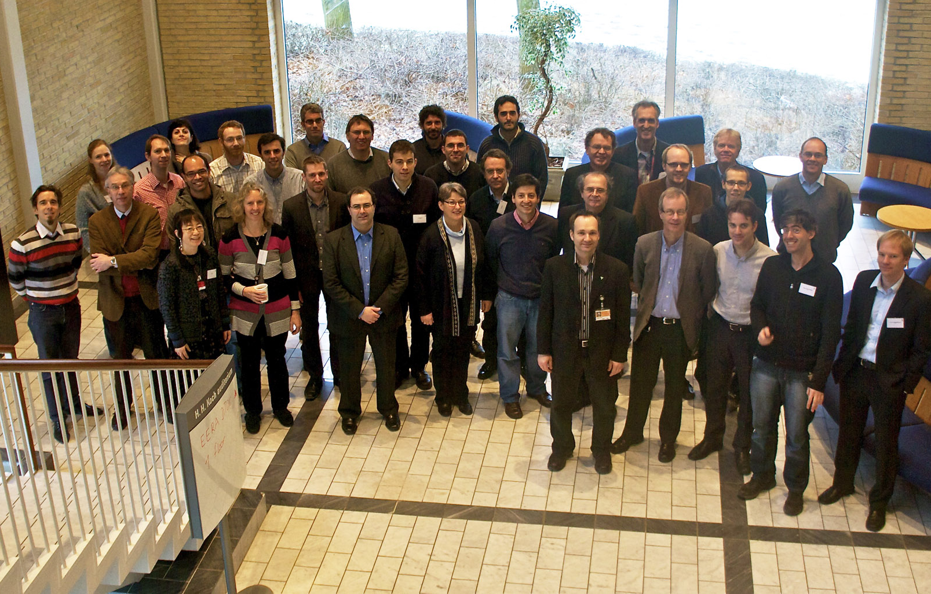

Thank you very much for your attention

