Slide 2
EERA-DTOC
EERA = European Energy Research Alliance
DTOC = Design Tool for Offshore Clusters
Project period: January 2012 to June 2015
Funding total ~4M Euro, hereof ~2.9M Euro from EU FP7

Slide 3
EERA-DTOC partners
DTU Wind Energy (former Risø DTU)
Fraunhofer IWES
CENER
ECN
EWEA
SINTEF
ForWind
CRES
CIEMAT
University of Porto
University of Strathclyde
Indiana University
Collecte Localisation Satellites
Statkraft
Iberdrola Renovables
Statoil
Overspeed
BARD
Hexicon
Carbon Trust
E.On
RES

Slide 4
FP7 call
EU FP7 funding based on proposal for the
Topic ENERGY.2011.2.3-2:
Development of design tools for Offshore Wind farm clusters
Open in call: FP7-ENERGY-2011-1
Funding scheme: Collaborative project

Slide 5
FP7 call: objective
The objective of this topic is to develop new design tools to optimise the exploitation of individual wind farms as well as wind farm clusters, in view of transforming them into virtual power plants.
Such design tools should integrate:
Spatial modelling: medium (within wind farms) to long distance (between wind farms) wake effects
Interconnection optimisation: to satisfy grid connection requirements and provide power plant system service.
Precise energy yield prediction: to ease investment decisions based on accurate simulations
The project should focus on offshore wind power systems and make optimal use of previously developed models.

Slide 6
FP7: expected impact
Funded projects are expected to demonstrate the capability of designing virtual wind power plants composed of wind farms and wind farm clusters while minimizing the negative spatial interactions, improving the overall power quality output and providing confidence in energy yield predictions.
Such projects will contribute to the development of offshore wind power as required by the SET-Plan.

Slide 7
EERA-DTOC main idea
Use and bring together existing models from the partners
Develop open interfaces between them
Implement a shell to integrate
Fine-tune the wake models using dedicated measurements
Validate final tool

Slide 8
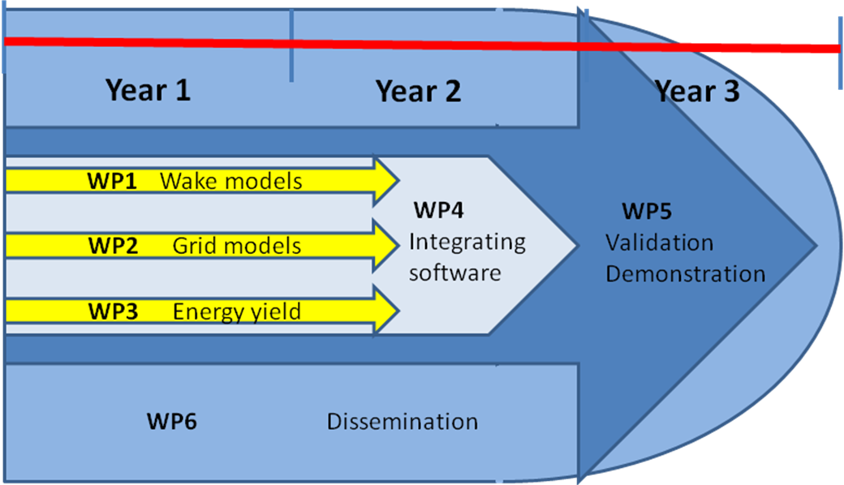
EERA-DTOC WP structure

Slide 9
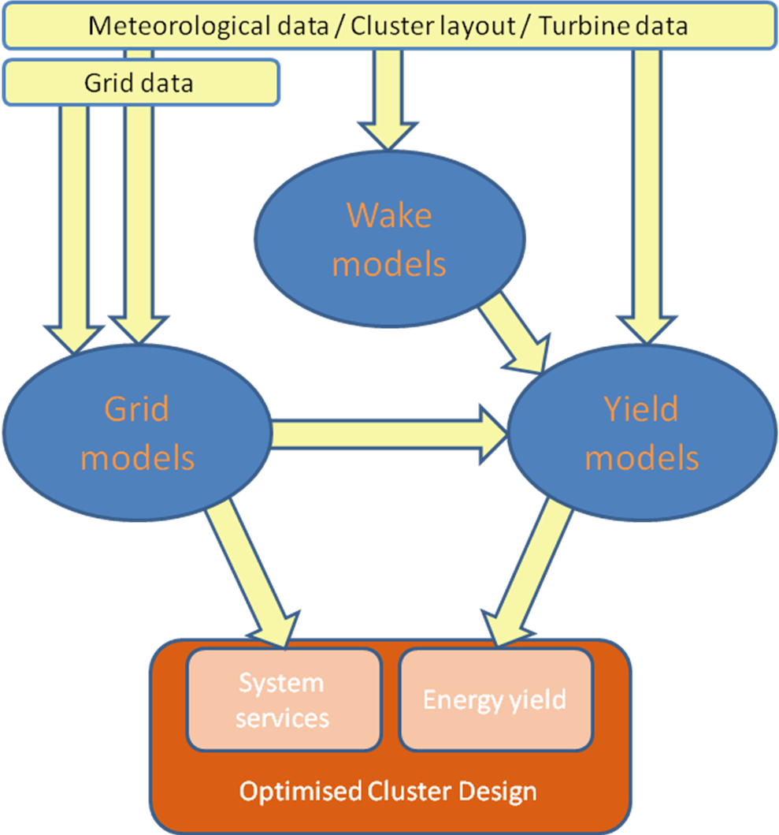
EERA-DTOC concept

Slide 10
EERA-DTOC vision
A robust, efficient, easy to use and flexible tool created to facilitate the optimised design of individual and clusters of offshore wind farms.
A keystone of this optimisation is the precise prediction of the future long term wind farm energy yield and its associated uncertainty.

Slide 11
EERA-DTOC vision (continued)
Robust, in the context of EERA-DTOC is understood to mean validated, stable, reliable, reproducible and technically convincing (e.g. would stand up to the scrutiny of an independent engineer during technical due diligence for project finance).
EERA-DTOC is to be built by integrating existing models (wake, grid, production etc.).
The design in question is that of the wind turbine layout (and/or wind farm clusters) and their associated electrical infrastructure. Design optimisation is with regard to the total cost of energy (including cost of finance). The EERA-DTOC tool will facilitate the optimisation process by supporting decision making through the efficient processing of many design scenarios for consideration in conjunction with separate cost/financial modelling tools.
At the individual wind farm level the anticipated users are primarily developers looking to optimise their specific wind farms subject to the influence of neighbouring wind farms.
At the cluster level the anticipated users are strategic planners looking to optimise the location of many offshore wind farms (and their associated electrical infrastructure) within a particular region.
In particular EERA-DTOC will focus on precisely predicting the wake losses, and associated uncertainty, due to both a specific offshore wind farm on itself (internal wake losses) and wake losses due to clusters of neighbouring offshore wind farms (external wake losses).

Slide 12
EERA-DTOC list of models
Name | Partner | Status | Programs | Input/ output | Script/ GUI | Database interface | IPR | Com
CFDWake | CENER |  | Fluent, C++, OpenFOAM | ASCII | script | Yes
CorWind | Risoe DTU | Ope | DOS exe Delphi | CSV files | no | no | + | +
CRES-farm | CRES | Ope | Linux/ Fortran77 | ASCII | no | no | +
CRES--flowNS | CRES | Ope | Linux/ Fortran77 | ASCII | no | no
DWM | Risoe DTU | Ope | Fortran, pc, pc-cluster | ASCII | script |  | +
ECNS | ECN | Beta | Linux/ Fortran90 | ASCII | No | No | +
EeFarm | ECN | Alpha | Matlab | Matlab scripts | Script/ GUI | yes | + | +
Farm-farm interaction | ECN | Ope | Fortran | ASCII | No | no | +
FarmFlow | ECN . | Ope | Delphi | ASCII/ binary | GUI | Yes | + | +
FlowARSM | CRES | Alpha | Linux/ Fortran77 | ASCII | no | no
FUGA | Risoe DTU | Ope | Fortran, C, Delphi, pc | ASCII | Script/ GUI | No | +
NET-OP | SINTEF | Proto type | Matlab | ASCII | script | No | +
Skiron/WAM | CENER | Ope | Unix/ Fortran | GRIB | script | yes
TOPFARM | Risoe DTU | Beta | Matlab/C/ Fortran | ASCII | script |  | +
UAEP | Risoe DTU |  | Matlab, pc | ASCII/ binary | no | yes
VENTOS | UPorto | Beta | Unix/ Fortran | ASCII | no | yes | + | +
WAsP | Risoe DTU | Ope | Windows pc | ASCII | Script/ GUI | No | + | +
WCMS | Fraunhofer | Ope | Matlab/JAVA | OracleDB |  | yes | +
WRF | Risoe DTU | Ope | Unix, Linux, Fortran90 | netCDF | Shell script | yes
WRF/ROMS | CIEMAT | Ope | Linux/ Fortran | netCDF | script | yes | +

Slide 13
EERA-DTOC highlights
Measurement campaign – depends on other project (ForWind and BARD). Several WindScanners, high-res satellite pictures, etc.
Measurements from Fraunhofer IWES – Lidar on boat
Well-tuned wake models for the inter-wind farm scale
Grand unified tool

Slide 14
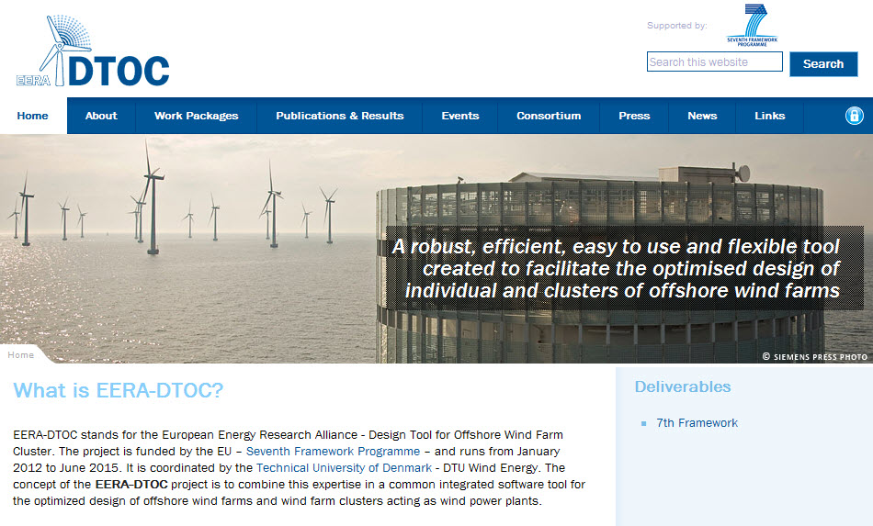
EERA-DTOC web www.eera-dtoc.eu

Slide 15
EERA-DTOC poster at EWEA 2012

Slide 16
EERA-DTOC at DTU Wind Energy stand, EWEA 2012

